Slide 1

Solidity Security (Re-entrancy Attacks)
- Jun Wei

Slide 2
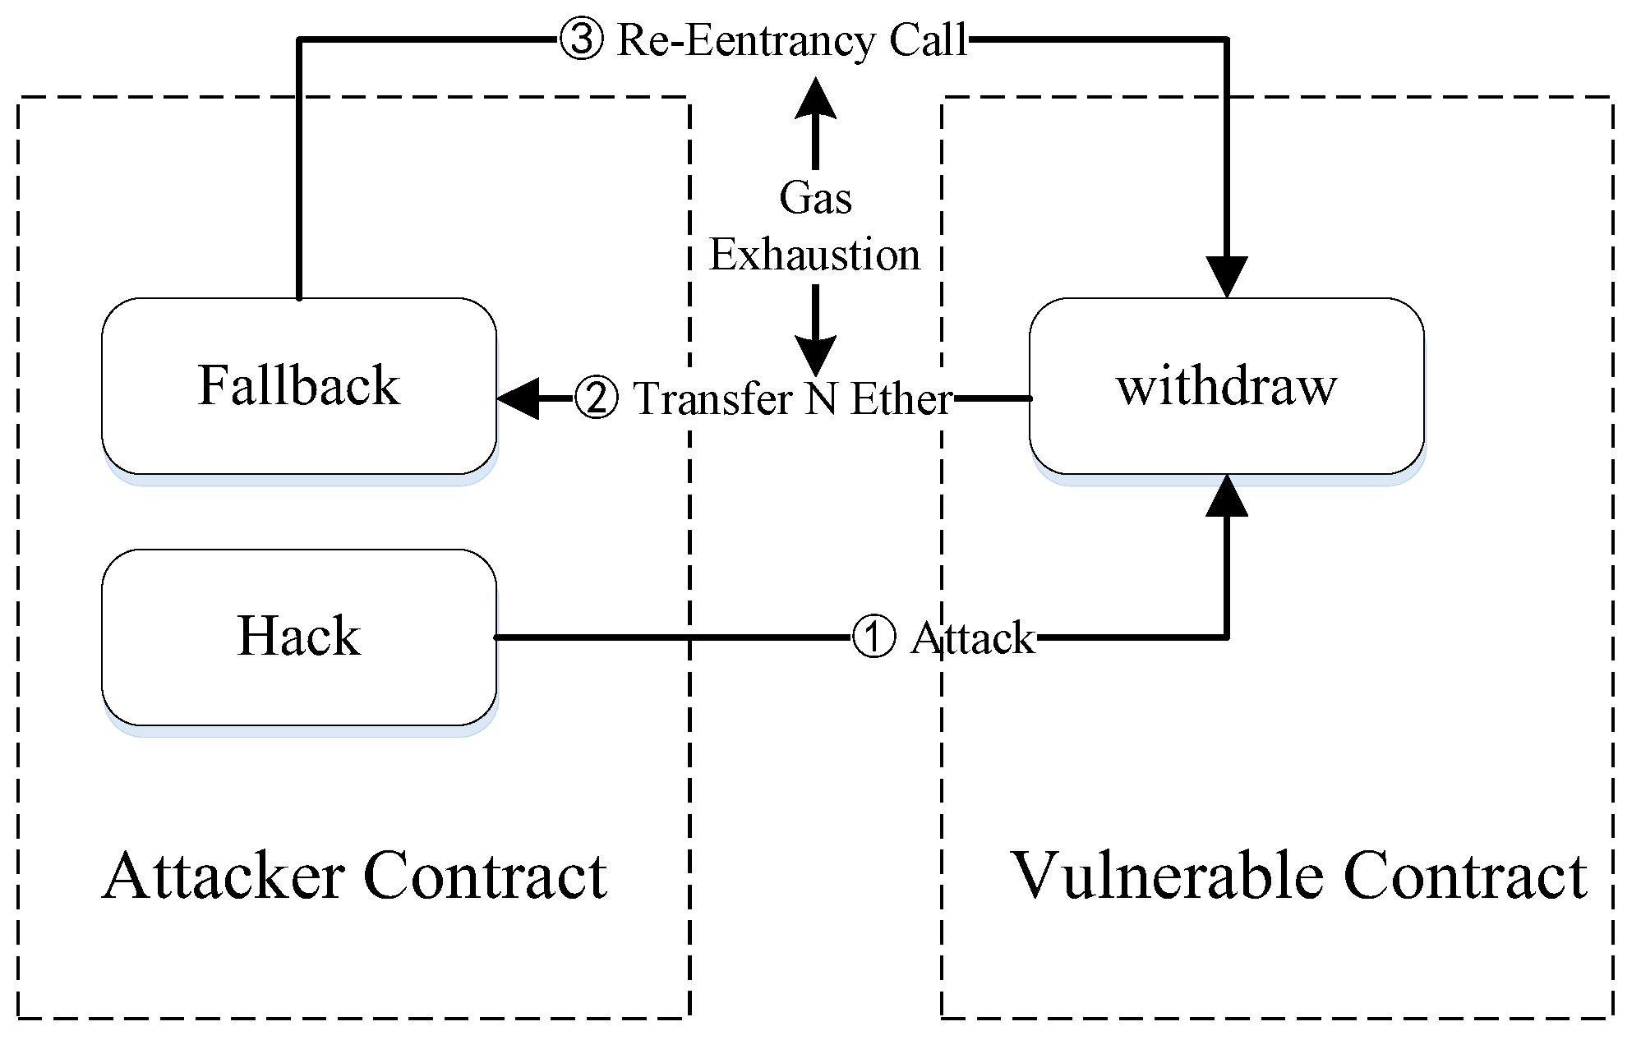
What is Re-Entrancy?
A Re-entrancy attack is a type of smart contract vulnerability where an exploiter contract leverages the loophole of the victim contract to continuously withdraw from it until the victim contract goes bankrupt.

Slide 3
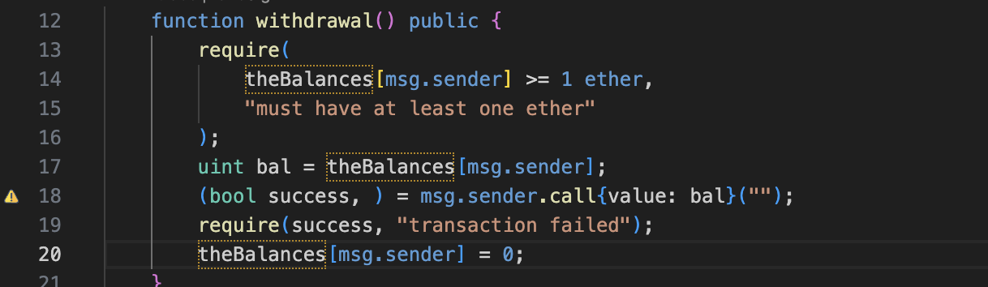
Vulnerable Code
When calling withdraw, the contract sends the ETH back to the caller before updating its state to 0.
If I can call withdraw multiple times before it hits line 20, effectively, I could withdraw more than what I deposited.

Slide 4
How do i Exploit this?
I create a new Smart Contract called “TheAttacker.sol”
Deposit 1 ETH
Calls the Withdraw Function
Upon receiving the ETH, calls the withdraw again
Continuously loops till the contract runs out of ETH

Slide 5
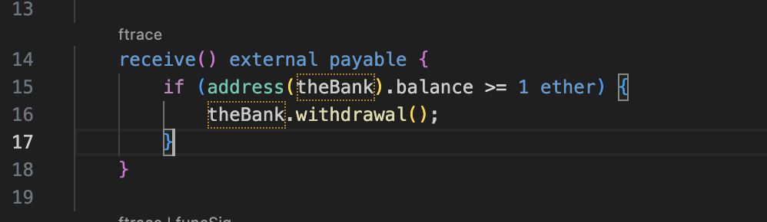
The code
Simple Exploit, on receive of funds, i call withdraw again

Slide 6
Types of Re-Entrancy Attacks
Mono-Function Reentrancy
Cross-Function Reentrancy
Cross-contract Reentrancy
Delegated Reentrancy

Slide 7
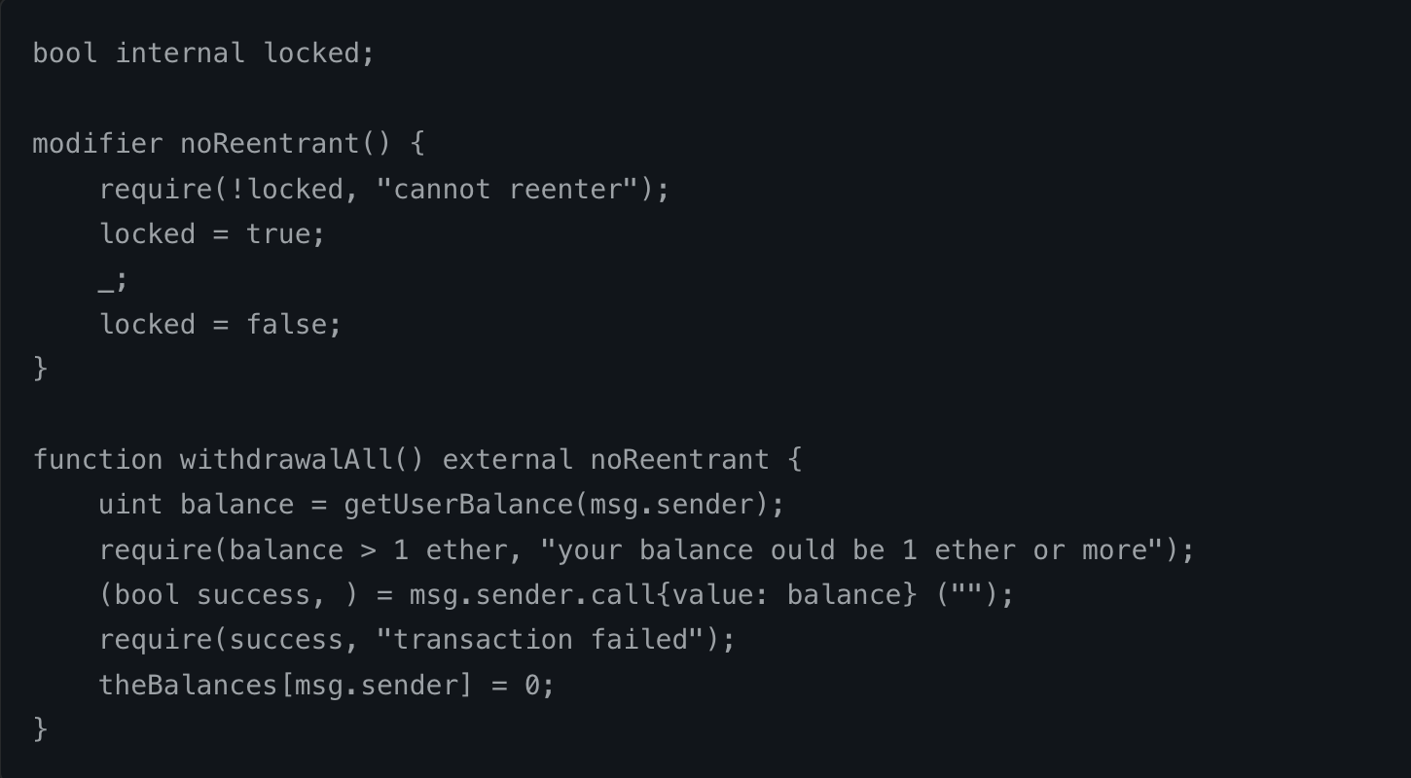
How do I fix this?
Reentrancy Guard

Slide 8
Found in other programming languages
Like Mutexes in Python
Locks the state of a variable, commonly found in threading

